Slide 1
Building Volume Based Capacity Estimation Using ALKIS and OpenStreetMap

Slide 2
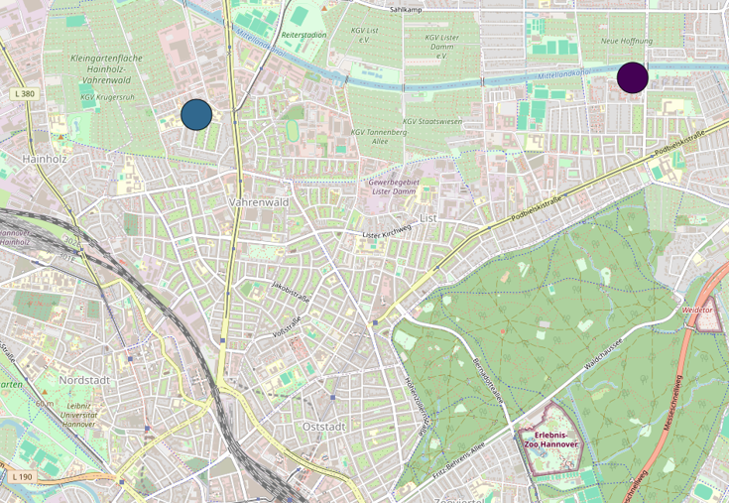



Motivation for Building Capacity Estimation
To estimate the capacity of individual buildings based on their type of use.
e.g. supermarkets, shopping centers, etc.
Capacity represents potential, attractiveness, or service intensity.
These terms are used interchangeably in this context.
Capacities serve as a key input parameter for the CARLA algorithm.
Enable realistic modeling of activity distribution across the urban environment.
Existing literature does not consider building capacities.
Activities not associated with buildings (e.g. parks, open spaces) are not covered in this approach but can be added for future work.

Slide 3
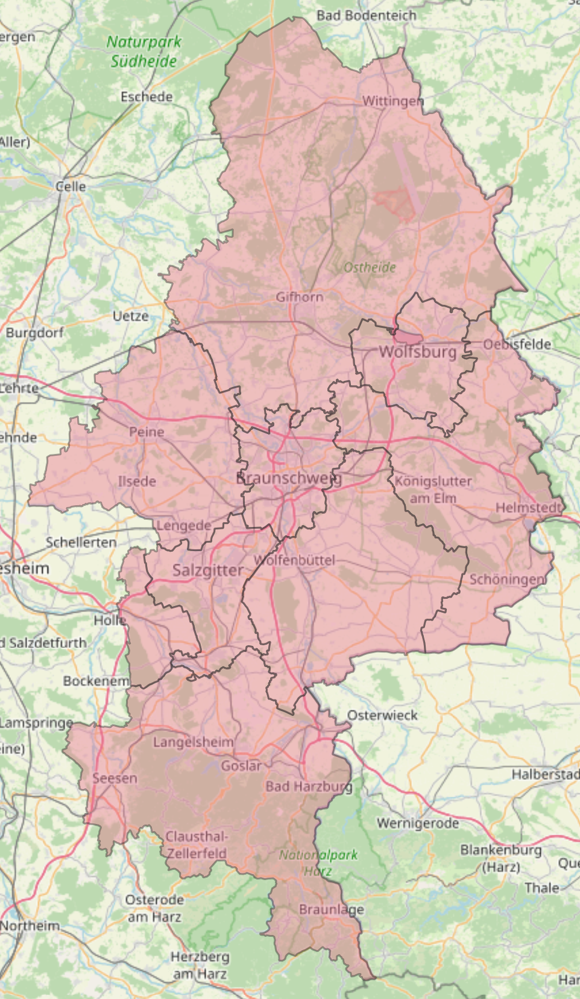
Study Area and Data Sources
Study Area: Braunschweig Großraum region.
ALKIS (LOD2) Building Data:
Authoritative building dataset.
High geometric and structural accuracy.
Reliable source for building geometry and volume estimation.
OpenStreetMap (OSM) Data
Detailed information especially for public locations.
Well labeled buildings and points of interest (POIs) in urban regions.
Why Combine ALKIS and OSM?
OSM captures functional and usage related information, especially for frequently visited public places.
ALKIS fills spatial and structural gaps where OSM data is incomplete or missing.
Combining both datasets leverages the strengths of authoritative and volunteered geospatial data.

Slide 4
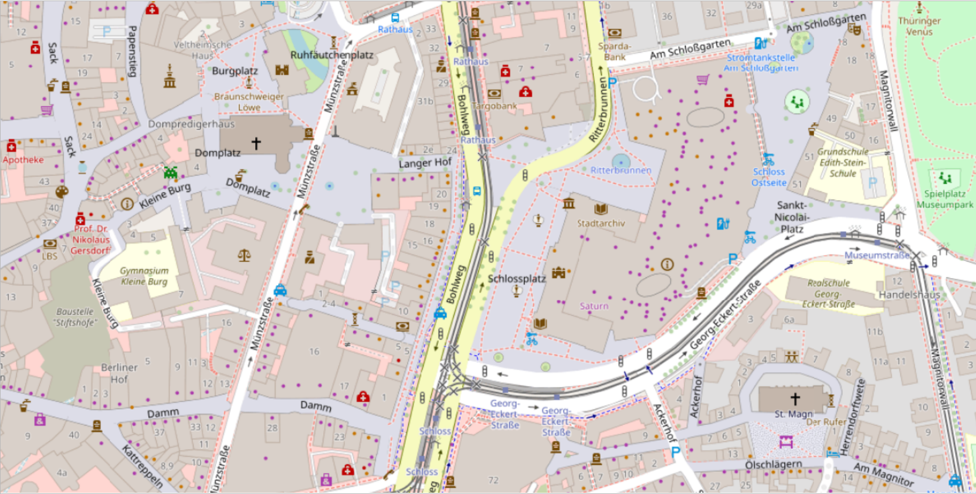
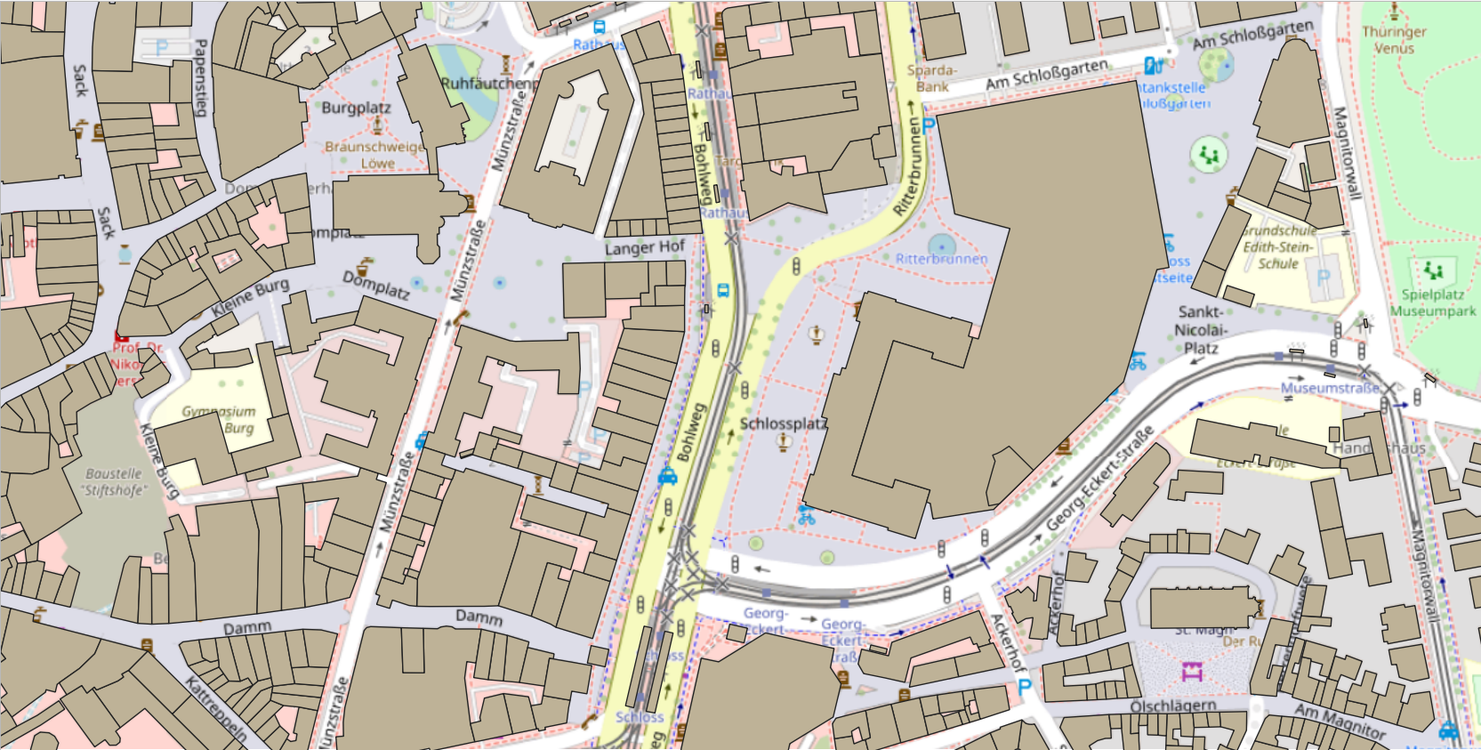
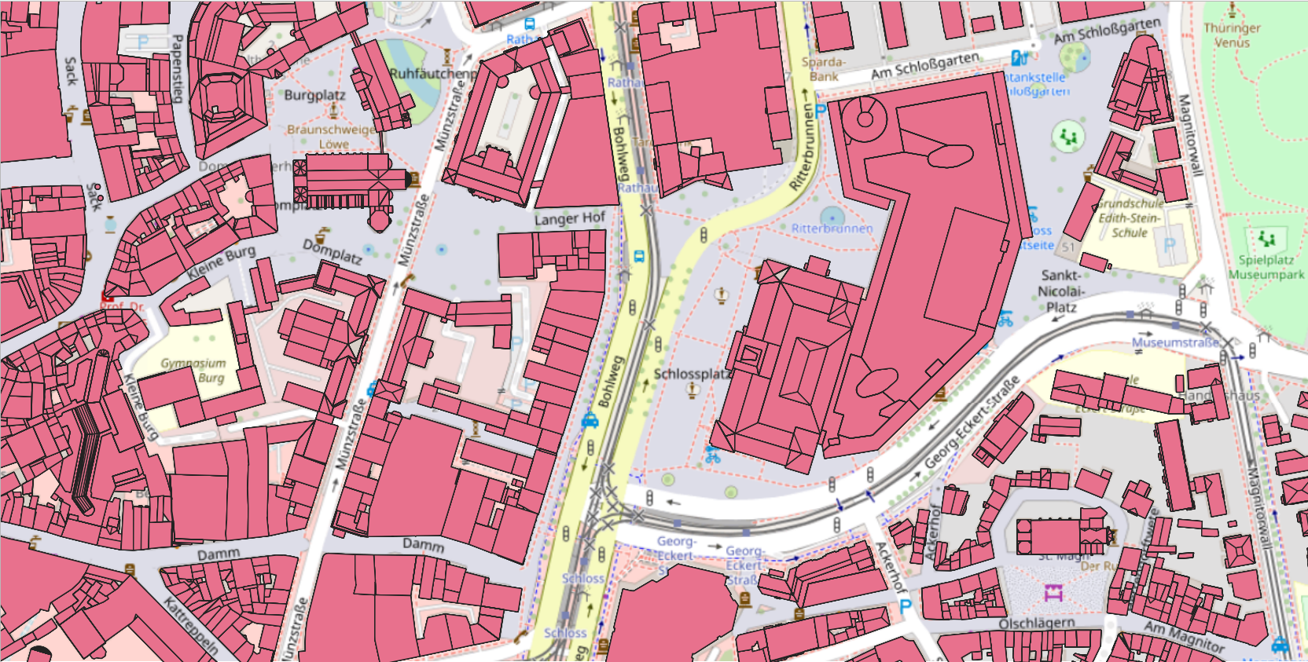
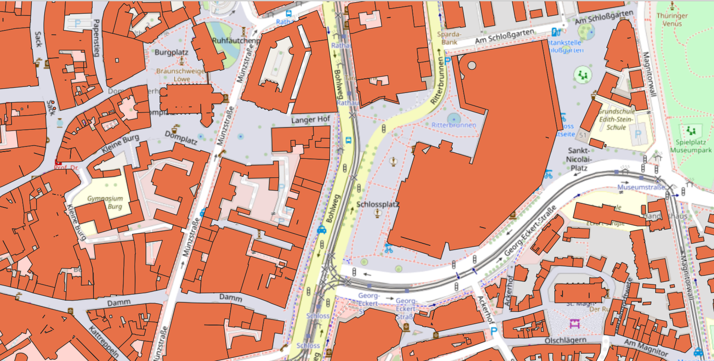
Input Data & Data Characteristics
OpenStreetMap (OSM) Building Data
Building footprints represented as polygons.
Well-suited for area estimation.
No height information available.
ALKIS LOD2 Building Data
High-resolution geometric building representation.
Includes height information, enabling volume estimation.
Structurally detailed with overlapping and segmented polygons.
Too detailed for direct capacity estimation.
Geometry Simplification and Alignment
ALKIS geometries are merged and simplified.
Excess overlapping polygons are removed.
Resulting geometries are aligned with OSM building footprints.

Slide 5
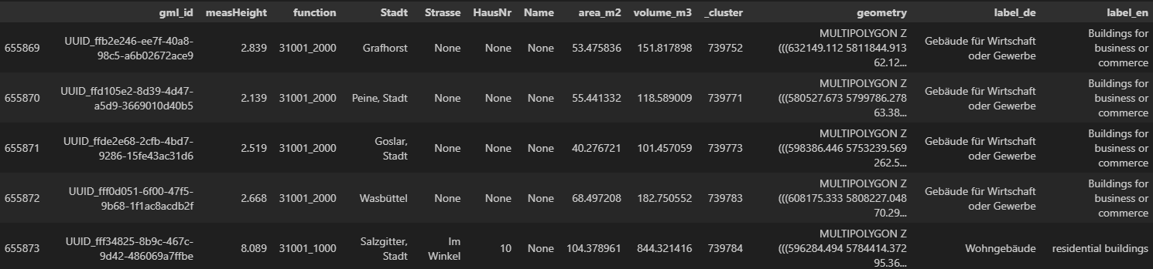
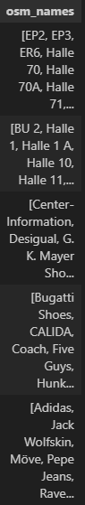
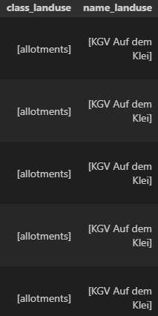
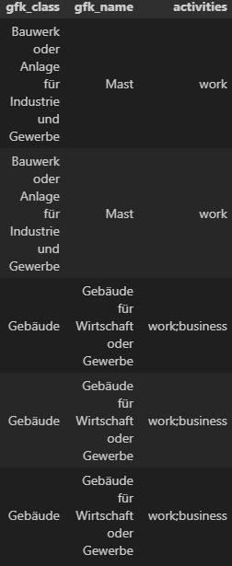
Enriching Building Data
Maximize available information to assign
buildings to correct categories.
Input data contains partial and inconsistent
attributes.
Buildings with mixed-use functions
(e.g. business and leisure).
Additional attributes are merged from multiple data sources.
Each source fills gaps left by others.
LLM-based classification approach:
Selected attributes (highlighted in red) serve as input features.
Output: assignment to categories such as essential activities, non-essential activities, workplaces, etc.
Richer and more diverse input information:
Improves classification robustness.
Leads to more reliable capacity estimation.

Slide 6
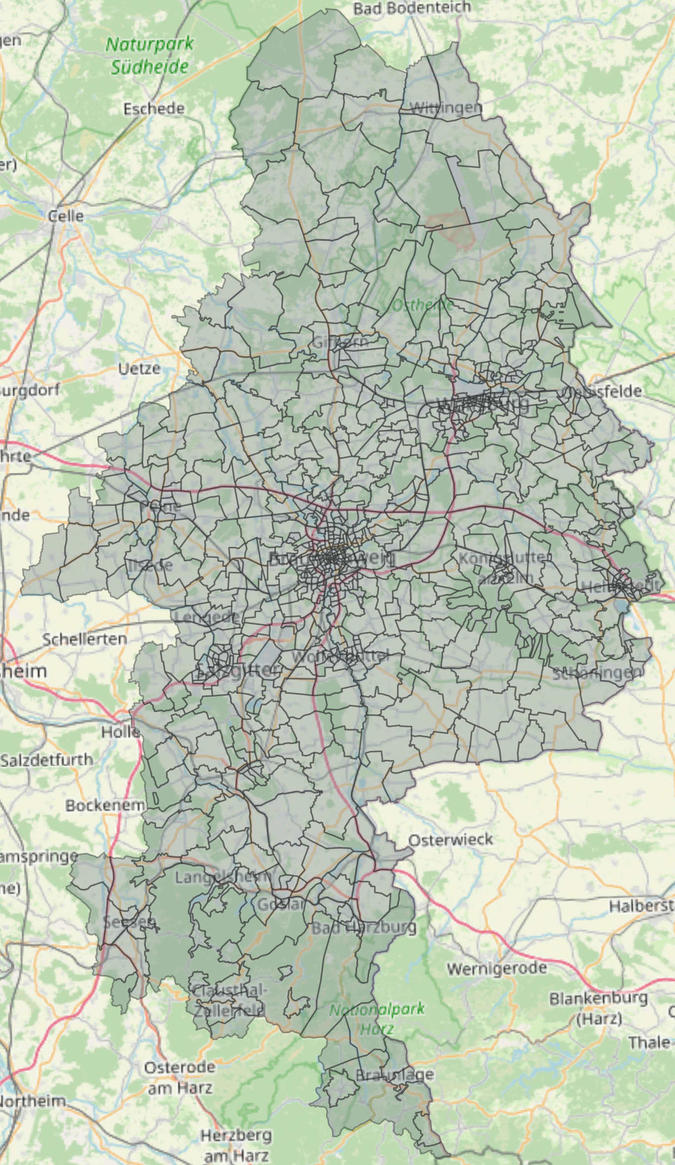
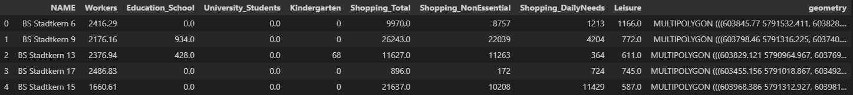
Methodology
PTV dataset provides weights for each category.
Defined for spatial regions covering the study area.
Characteristics
Smaller regions in high population density areas.
Larger regions in low population density.
Structure
Each region contains weights for multiple categories.
Goal: Redistribution to Building Level
Redistribute region level weights to individual buildings
Ensure sum of building weights equals total regional weight.

Slide 7
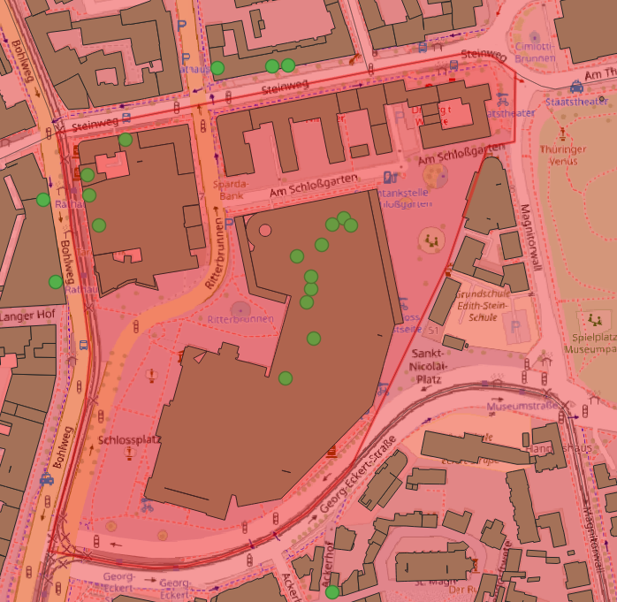
Methodology
Weights are assigned to buildings based on the activities occurring within them.
Points of Interest (POIs) indicate building activities.
Here, green dots represent essential activities
e.g. supermarkets, bakeries, butcher shops, etc
Volume-based redistribution
Building volume is divided according to the number of POIs.
Each POI contributes proportionally to its respective activity category.
This reflects real-world usage.
Ensures a more realistic capacity distribution as buildings are often multi-functional.

Slide 8
Challenges and ideas
Do estimated volumes/capacities represent real-world senarios?
Direct ground-truth data is absent for validation:
Use reference tables (e.g. Bosserhoff) as baseline for plausibility checks.
Dynamic capacity assignment:
Use a Graph Neural Network (GNN) to learn capacities.
Inputs: road network connectivity + building features derived earlier (volume, POIs, land-use/building-use, etc.)
Goal: infer more realistic, context-aware capacities beyond rule-based allocation.
Main remaining challenge: Validation
Use open or publicly available ground-truth available, e.g.:
number of students for universities.
employee counts for known workplaces.
other official/open institutional statistics where available.

